Slide 1
Whac-a-Dolores
By: Andrea Mora

Slide 2
About me
Where are you from?
I’m from Venezuela, but I’ve been living in Madrid for about a year and a half.
I have no background on tech, so this has been a whole new world for me.
Some facts about me:
I love true crime related content, maybe a little too much.
I sneeze with the sun or strong lights, it’s called photic sneeze reflex and 15-30% of population have it. 🤧
My earphones are almost an extension of my ears, I’m always listening to something.

Slide 3
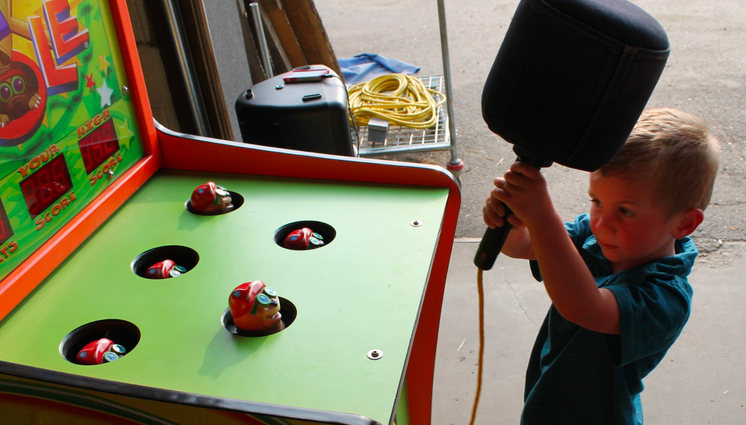
Project elevator pitch
What is your project?
An online version of the Whac a Mole arcade game with a little twist and Harry Potter inspiration.
How does it work?
1- Players try to click on an image of either Dolores Umbridge or Dobby as they randomly appear on a grid of squares.
2- Clicking on Dolores earns the player points, clicking on Dobby costs the player a life.
3- The game ends when the player runs out of time or lives.
4- It includes features such as a high score tracker, a timer, and different levels of difficulty as the timer runs down.
Why did you choose it?
I was looking for ideas an it seemed like a fun challenge. Little did I know I was going to suffer a bit with it 😄

Slide 4
Technical Challenge
What was the most important technical challenge you faced?
Using timing events made it difficult to add a second character that has a different condition than the first one. Whenever a Dolores was clicked and a Dobby was drawn afterwards it counted the click also for Dobby and ended the game.
How did you overcome that challenge?
Detecting the collision and either ending the game or updating score right on the mouse event (click).

Slide 5
Big mistake
What was the biggest mistake you made during this project?
Using a “Hit” variable to detect if Dobby was hit during the game interval and then continue with the update of the score.
This variable had to become false after the click but there was not enough time before the drawing of the next square.
What did you learn from it?
Perform the actions directly on the event.
I got rid of the variable and instead included the end game, update score and update lives actions on the mouse event.

Slide 6
DEMO
https://whac-a-dolores.netlify.app/

Slide 7
Whac-a-Dolores
THANK YOU! ☺️

